Slide 1

Patuakhali Science and Technology University
Faculty of Computer Science and Engineering
CCE 322 :: Computer Peripheral and Interfacing Sessional Project Proposal

Slide 2
HeartGuard AI: AI-Powered ECG Analysis System
A revolutionary IoT and AI-based solution for cardiac health monitoring.
1
2
Submitted by:
Submitted to:
MD. AFRIDI ALOM PRANTO (2102027)
Sarna Majumder, Associate Professor
SANDIPTA SAHA (2102056)
Prof. Dr. Md Samsuzzaman, Professor
NAZMUS SAKIB (2102066)
Dept. of Computer and Communication Engineering, PSTU
MOHAMMAD FARHADUL HAQUE FUAD (2102067)
MD. NAZMUL HASAN KHOKUN (2102068)
MD. TOFAIEL HUSSAIN TOTA (2002079)
Submission Date: 25 January 2026

Slide 3

Introduction: Bridging the Cardiac Care Gap
Cardiovascular diseases are a leading cause of mortality, especially in developing countries like Bangladesh, where advanced diagnostic tools are scarce.
Traditional ECG machines are expensive, require specialized technicians, and lack real-time analysis, leading to delayed diagnoses and increased health risks.
HeartGuard AI aims to democratize cardiac health monitoring, making it accessible to rural clinics, homes, and primary healthcare providers.

Slide 4
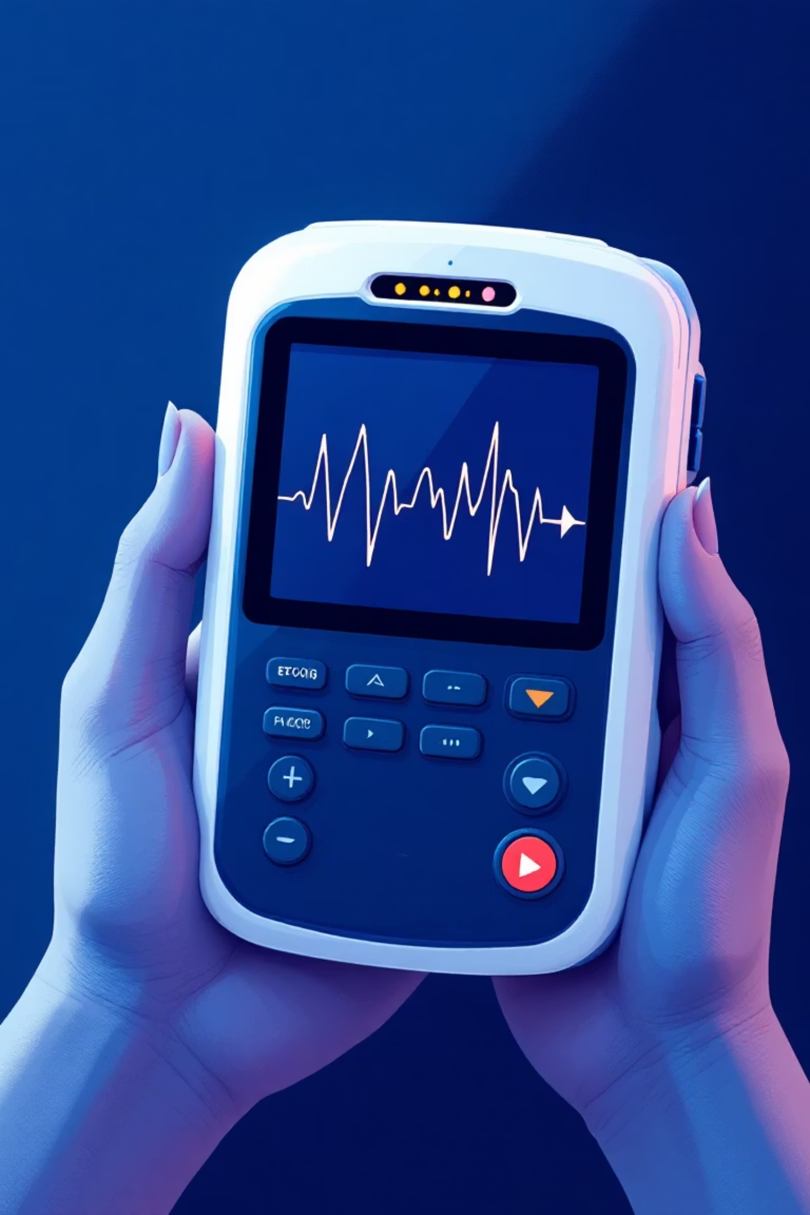
HeartGuard AI: Our Objectives
Real-time ECG Monitoring
Acquire and process ECG signals using affordable sensors for immediate analysis.
AI-Based Disease Detection
Use machine learning models to identify cardiac conditions with high accuracy.
User-Friendly & Portable
Develop a touchscreen GUI for non-experts and a low-cost, battery-powered design.
Comprehensive Assessment
Integrate ECG with heart rate, SpO2, and temperature monitoring.

Slide 5






The Problem: Cardiac Diagnostic Challenges
High Costs
Commercial ECG machines are unaffordable for small clinics.
Lack of Expertise
Rural areas lack cardiologists, leading to misdiagnoses.
No Real-Time Analysis
Manual interpretation is time-consuming and error-prone.
Limited Accessibility
Remote patients struggle to reach hospitals for checks.
HeartGuard AI provides an AI-driven, affordable ECG system to reduce healthcare disparities.

Slide 6

Project Scope: Functional & Technical
Functional Scope
Technical Scope
Patient registration & ID generation
Sensor integration with Raspberry Pi
ECG signal acquisition & processing
Filtering algorithms & ML models
AI analysis for disease detection
Python-based GUI & database
Report generation (PDF/SMS)
Power management for portability
Doctor review interface
Follow-up reminders & emergency protocols
Target Users
Rural clinics, primary healthcare centers, general practitioners, cardiologists, and patients requiring regular cardiac monitoring.

Slide 7
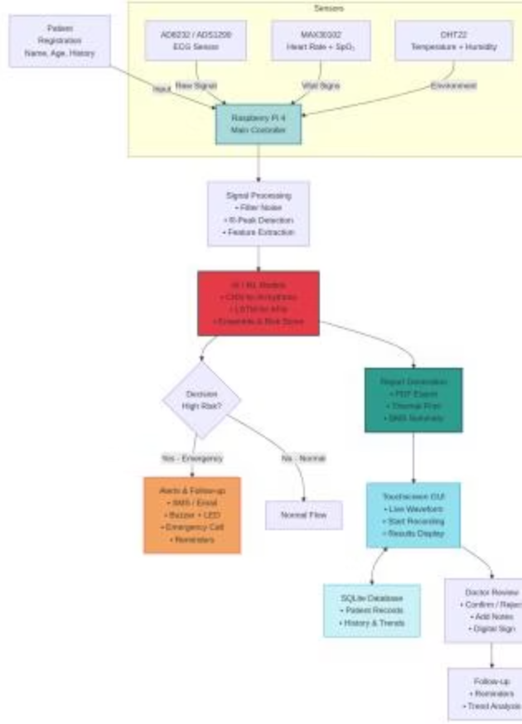
Methodology: System Architecture
Raspberry Pi: The Core
Signal acquisition & processing
AI model inference
GUI & database management
Report generation & alerts
Sensors connect via GPIO/ADC for data collection.
The block diagram illustrates the HeartGuard AI system architecture, showing Raspberry Pi connected to sensors, processing pipeline, AI models, and output interfaces.

Slide 8
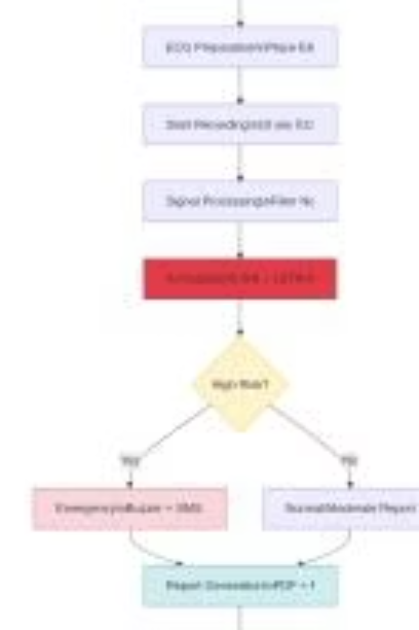
Working Methodology: Step-by-Step
01
Initialization & Registration
Power on, load models, patient details input.
02
ECG Recording & Processing
Electrode placement, 10-second recording, noise filtering, feature extraction.
03
AI Analysis & Reporting
Run ML models for diagnosis, risk score, PDF/SMS report generation.
04
Doctor Review & Follow-up
Confirmation, notes, schedule reminders, historical tracking.

Slide 9
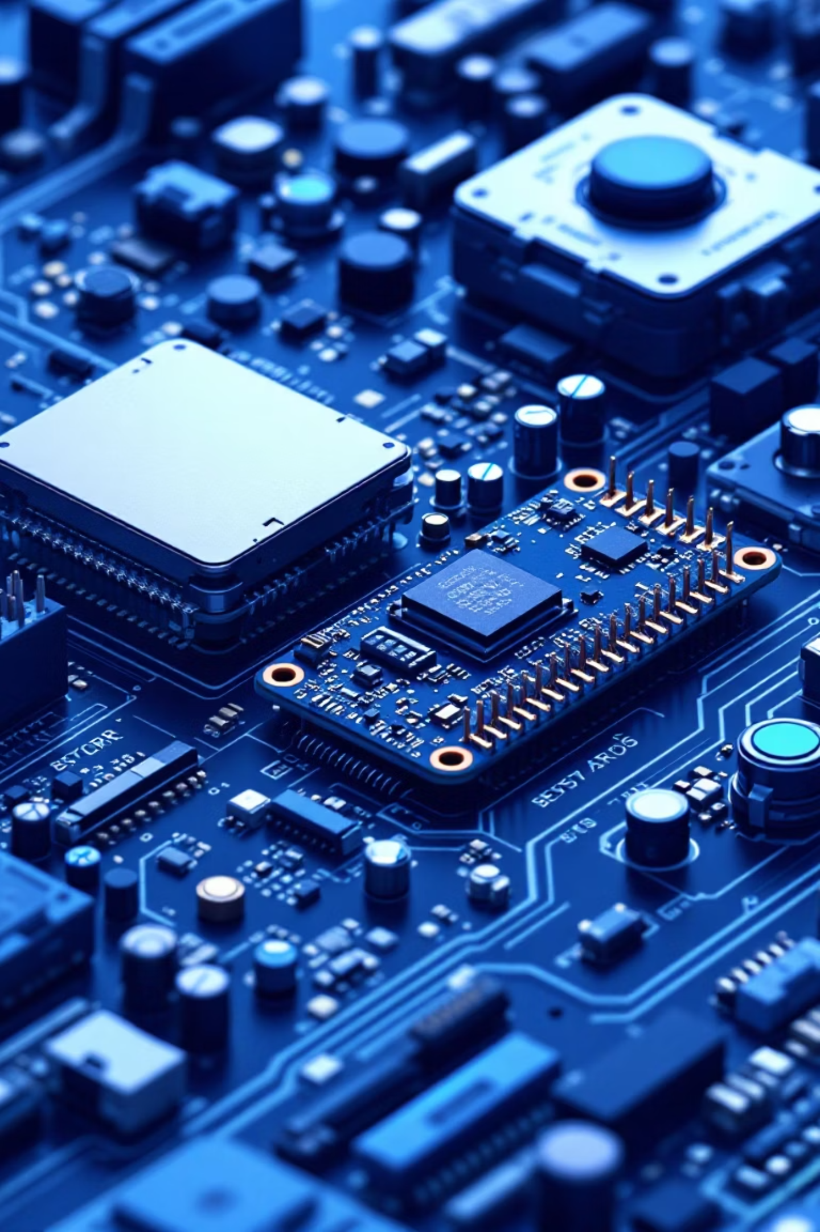
Technology Stack & Components
Hardware
Software
Raspberry Pi 4 (4GB)
Python 3.9+
AD8232 ECG Sensor
Raspberry Pi OS
MAX30102 Heart Rate + SpO2
TensorFlow/Keras (ML)
DHT22 Temperature Sensor
SciPy/NumPy (Signal Processing)
7" Touchscreen Display
Power Bank (20,000mAh)
PyQt5 (GUI)
SQLite (Database)
ReportLab (PDF Generation)
Estimated Cost (Basic Version): 21,555 BDT

Slide 10
Expected Outcomes & Future Vision
Affordable & Accurate
Life-Saving Interventions
Cloud & Mobile Integration
ECG analysis device with AI accuracy ≥ 95%.
Potential for early detection and improved health outcomes.
Remote access and monitoring via mobile app.
Advanced ML & Telemedicine
Miniaturization
Multi-disease prediction and integration with telemedicine platforms.
Future development for wearable devices.
HeartGuard AI revolutionizes cardiac care by making ECG analysis accessible and intelligent, contributing to better health outcomes in Bangladesh.

Slide 11
Thank You

